Slide 1



ESCAPE GAME
GROUP 5
Paola
Tania
Loredane
Jean Philippe
C
E
C
P
E
S
A
P
E
S
A
E
M
E
G
A
M
E
G
A
IRONHACK
J
J
C
O
E
C
R
O
E
P
R
T
P
T
PROJECT 1 - PYTHON

Slide 2
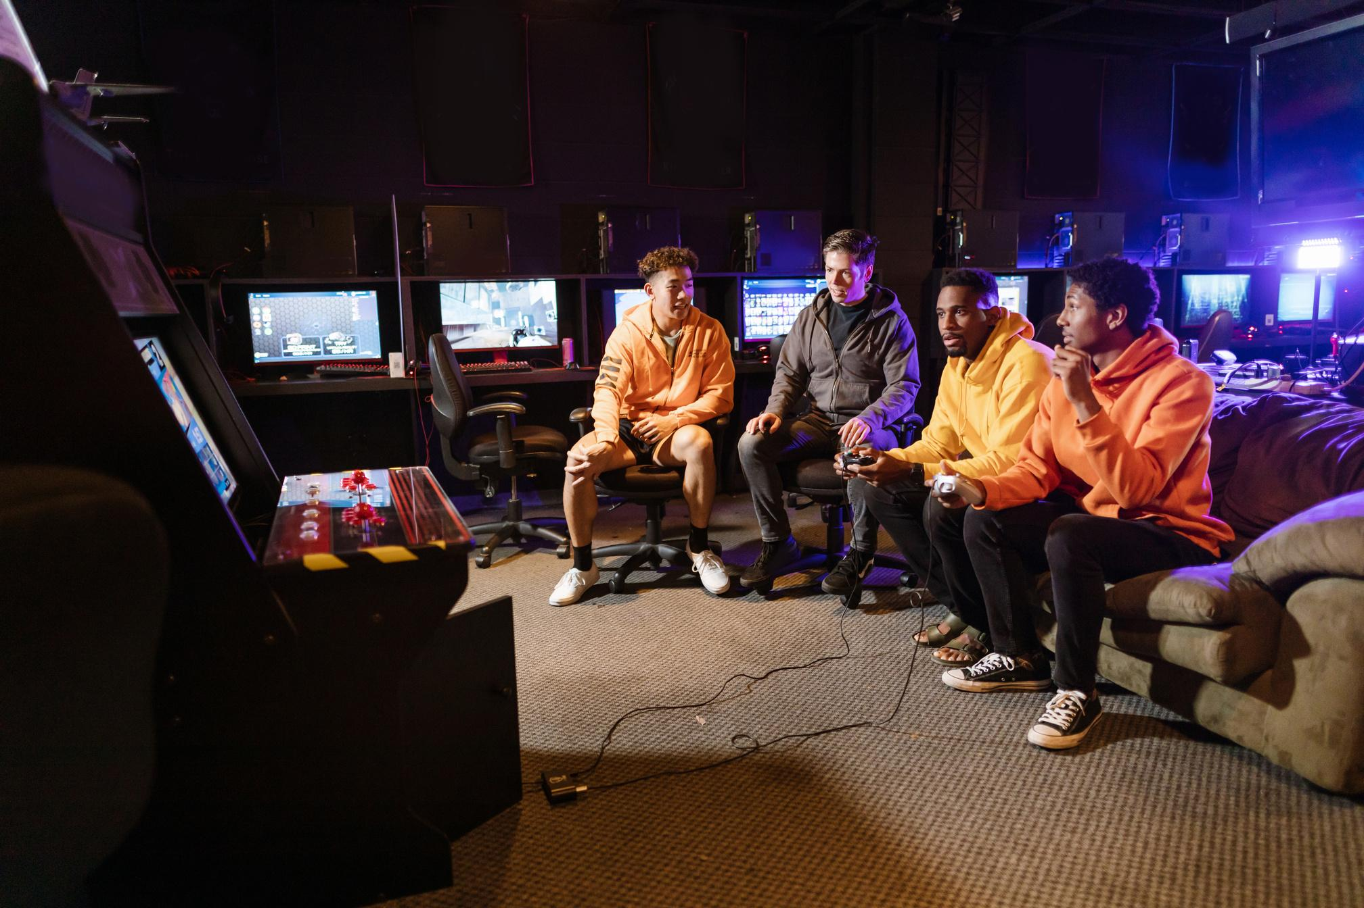
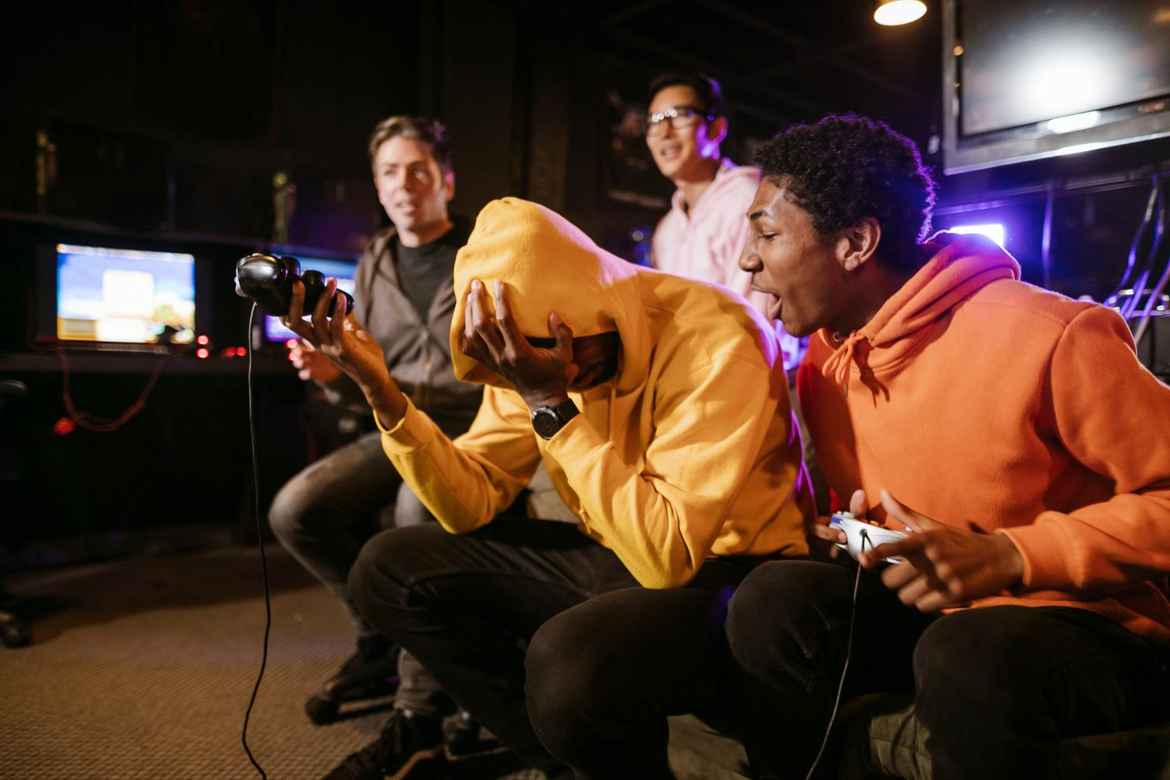
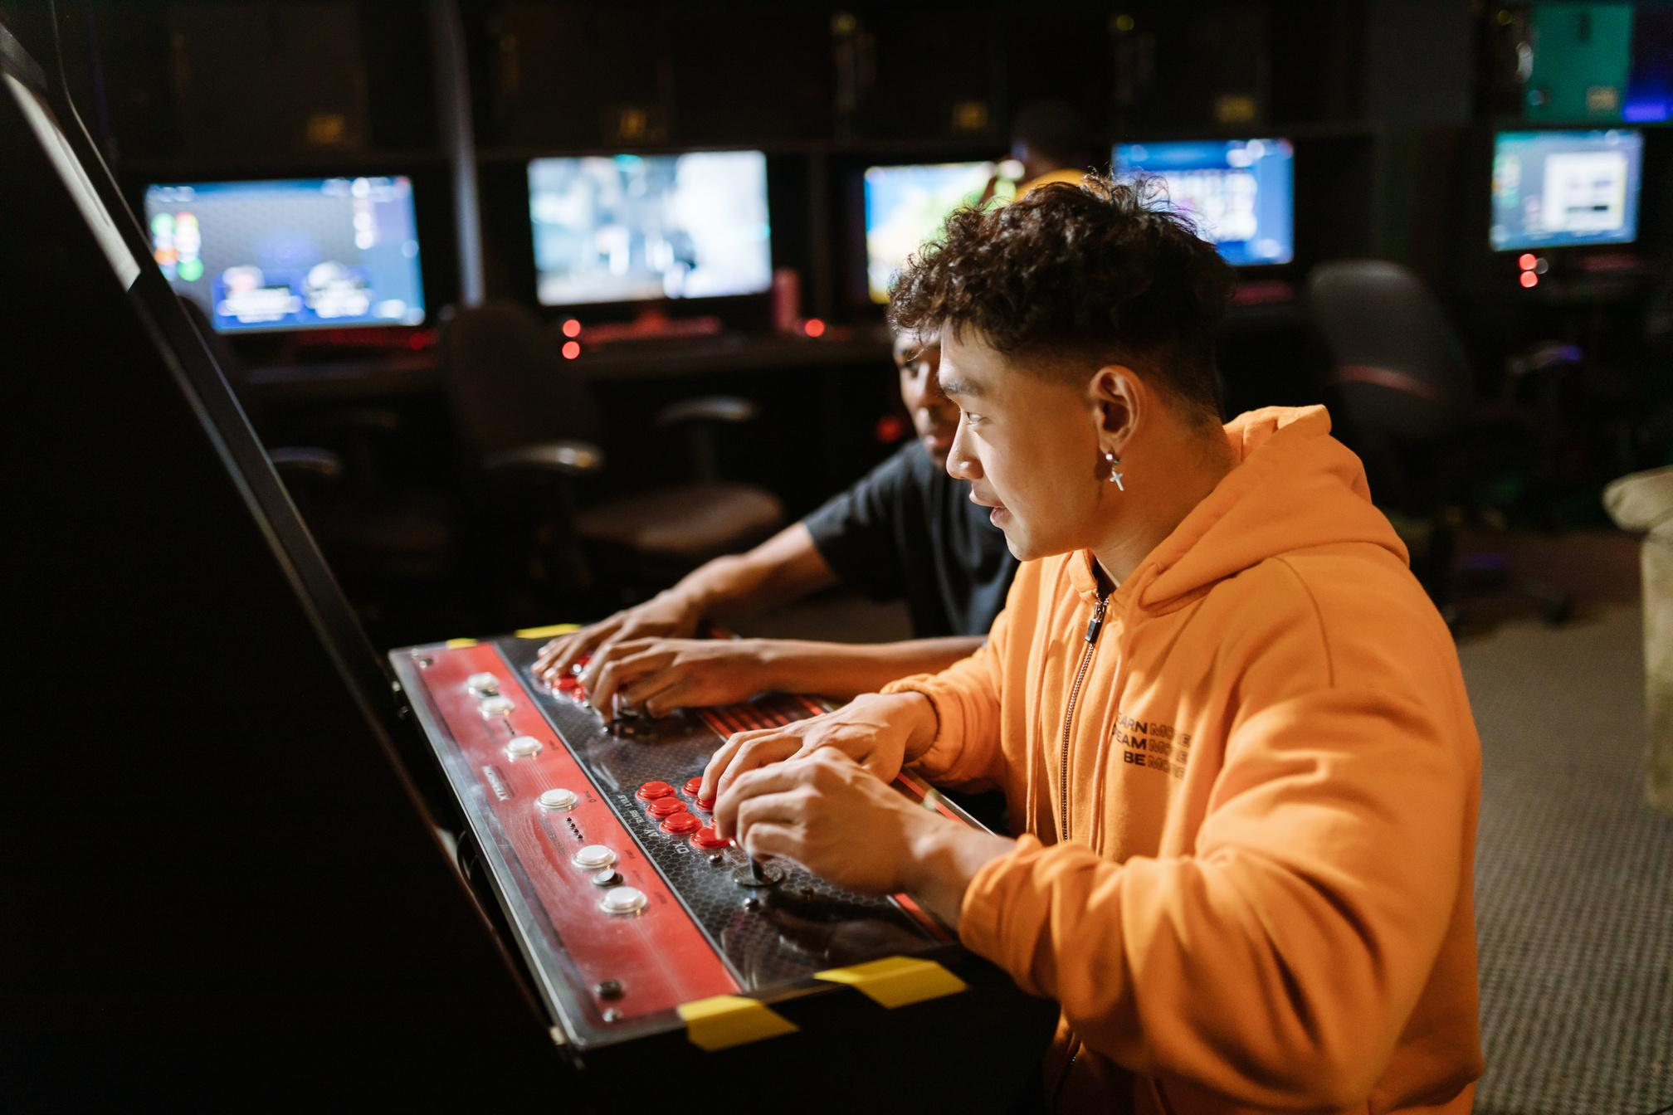
ESCAPE GAME
GROUP 5
Paola
Tania
Loredane
Jean Philippe
THE STRUCTURE
GAME FLOW
defined as dictionaries and lists
ROOMS AND ITEMS
01
GAME STA managed by a dictionary that tracks current rooms, key collected and status
GAME STATE
02
FUNCTIONS
start_game, play_room,
03
explore_room, examine_item, get_next_room
get_next_room_of_door

Slide 3



ESCAPE ROOM
GROUP 5
Paola
Tania
Loredane
Jean Philippe
THE TECHNICAL CHALLENGES
MANAGING GAME STATE AND ENSURING SMOOTH TRANSITIONS BETWEEN ROOMS AND ACTIONS
USED A DICTIONARY TO TRACK CURRENT GAME STATE
IMPLEMENTED FUNCTIONS TO HANDLE STATE CHANGES AND ROOM TRANSITIONS
IDENTIFY THE APPROPRIATE DATA STRUCTURE FOR EACH ELEMENT IN EACH ROOM, INCLUDING CATEGORY: FURNITURE, DOORS, AND KEYS
PSEUDOCODE AND REVERSE ENGINEERING
CREATE AN OBJECT THAT CONTAINS ALL THE RELATIONSHIPS BETWEEN THE ELEMENTS
CHALLENGE
METHOD
SOLUTION

Slide 4
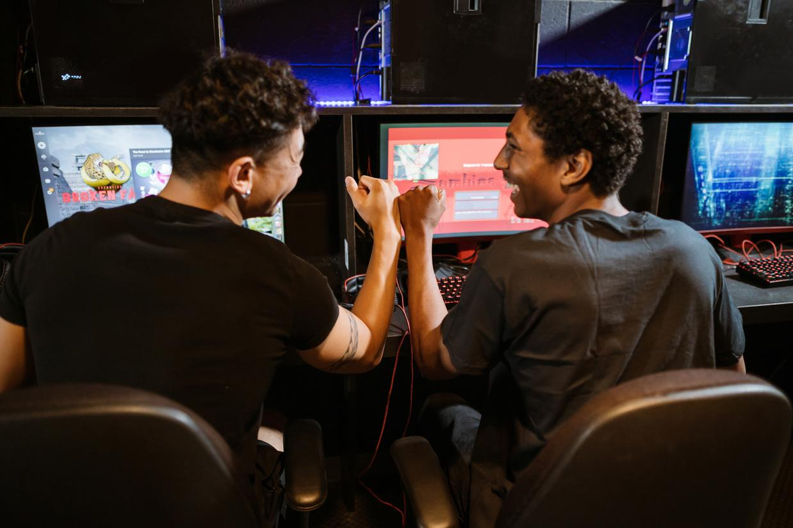
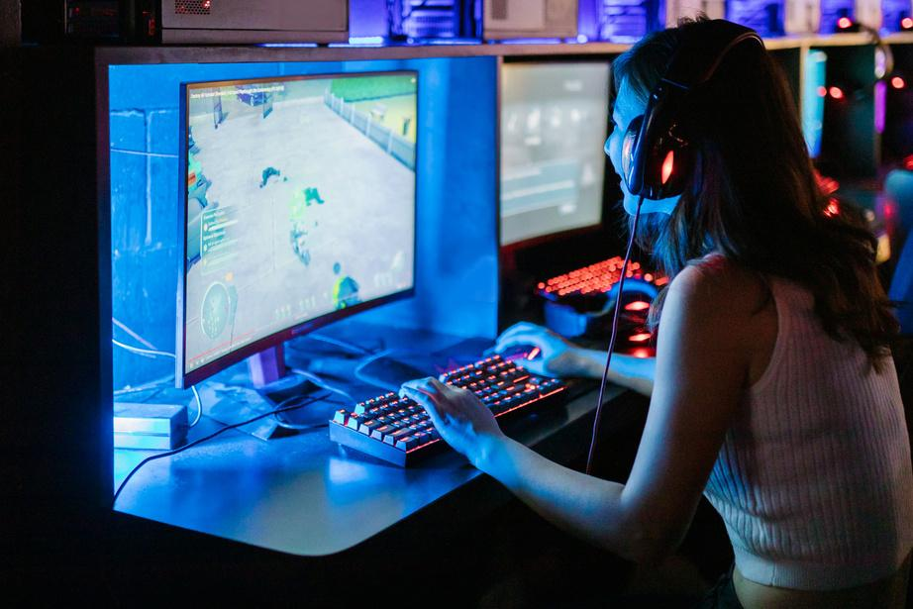

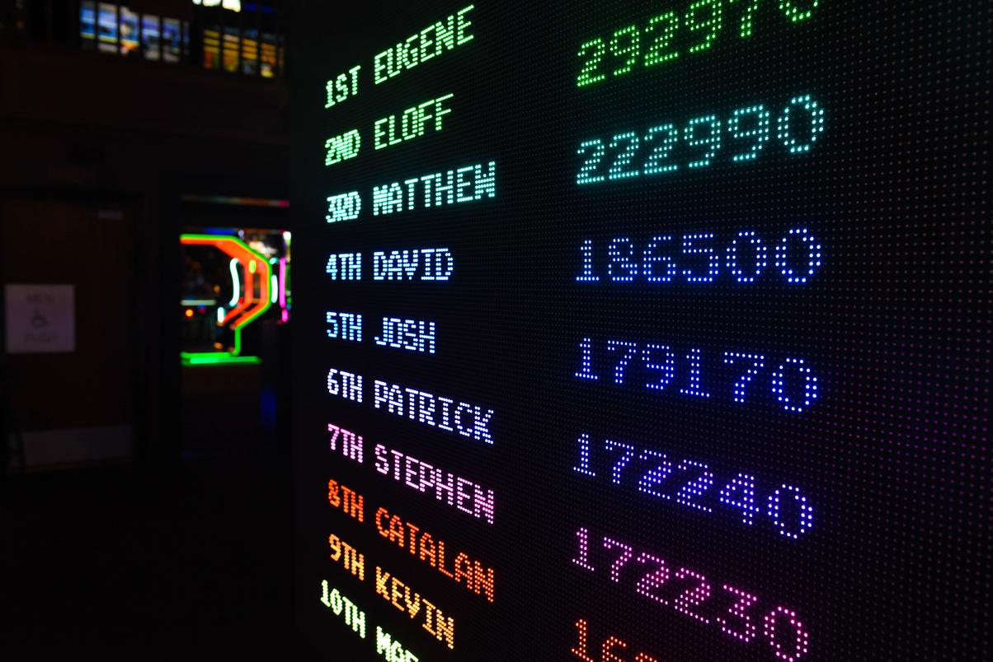
ESCAPE GAME
GROUP 5
Paola
Tania
Loredane
Jean Philippe
THE PROJECT OVERVIEW
MULTIPLE ROOMS AND ITEMS
INTERACTIVE EXPLORATION
KEY COLLECTION
GAME STATE MANAGEMENT
Rooms and Content of the rooms have been defined and listed.
Users have the choice of EXPLORING or EXAMINING Rooms and Items.
Once Key is collected, it can be used to unlock doors.
Keeps track of where you are in the game:
current_room, collected keys, target room
.

Slide 5
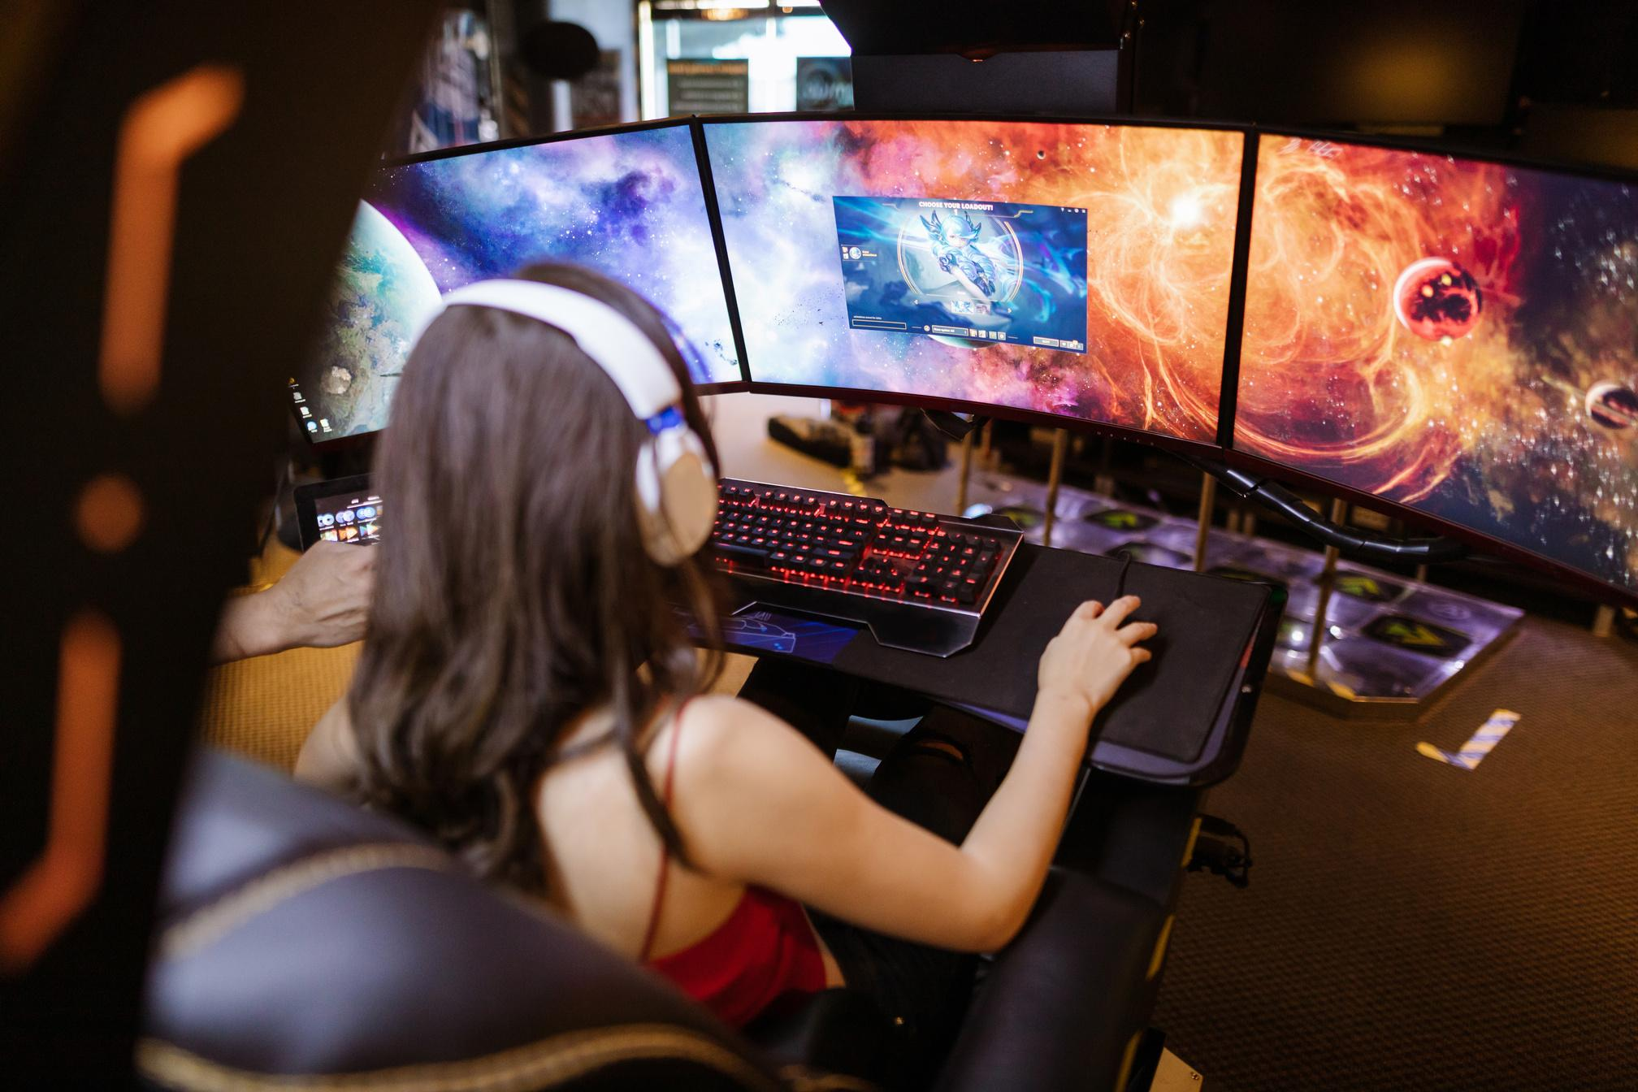
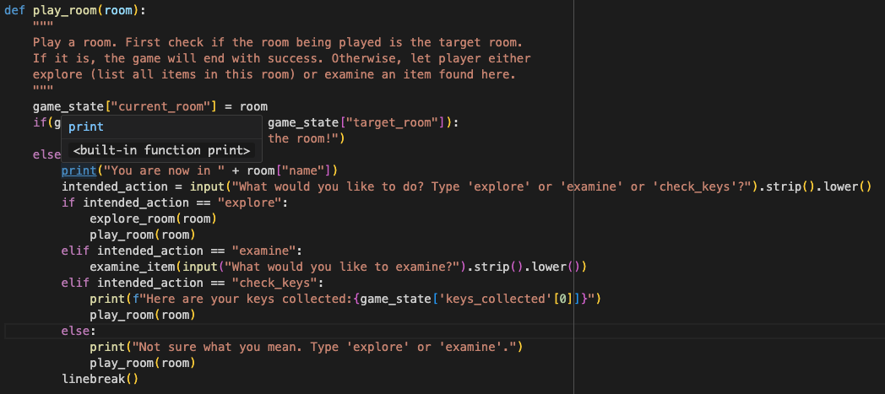
GROUP 5
Paola
Tania
Loredane
Jean Philippe
THE MISTAKES
We did not define Tests to verify the code and it weaknesses.
01
02
while coding we misused the relationships between objects which created wrong output to the user.
Tried to implement a check collected Key and display but failed:
03

Slide 6

ESCAPE GAME
GROUP 5
Paola
Tania
Loredane
Jean Philippe
DEMO PROJECT
PROJECT LINK
WORKING VERSION
The Link above will redirect you to a Google Collab workbook displaying our work for the Escape Room Game.
PROJECT LINK
( WORK IN PROGRESS )
DIFFERENT LANGUAGE

Slide 7
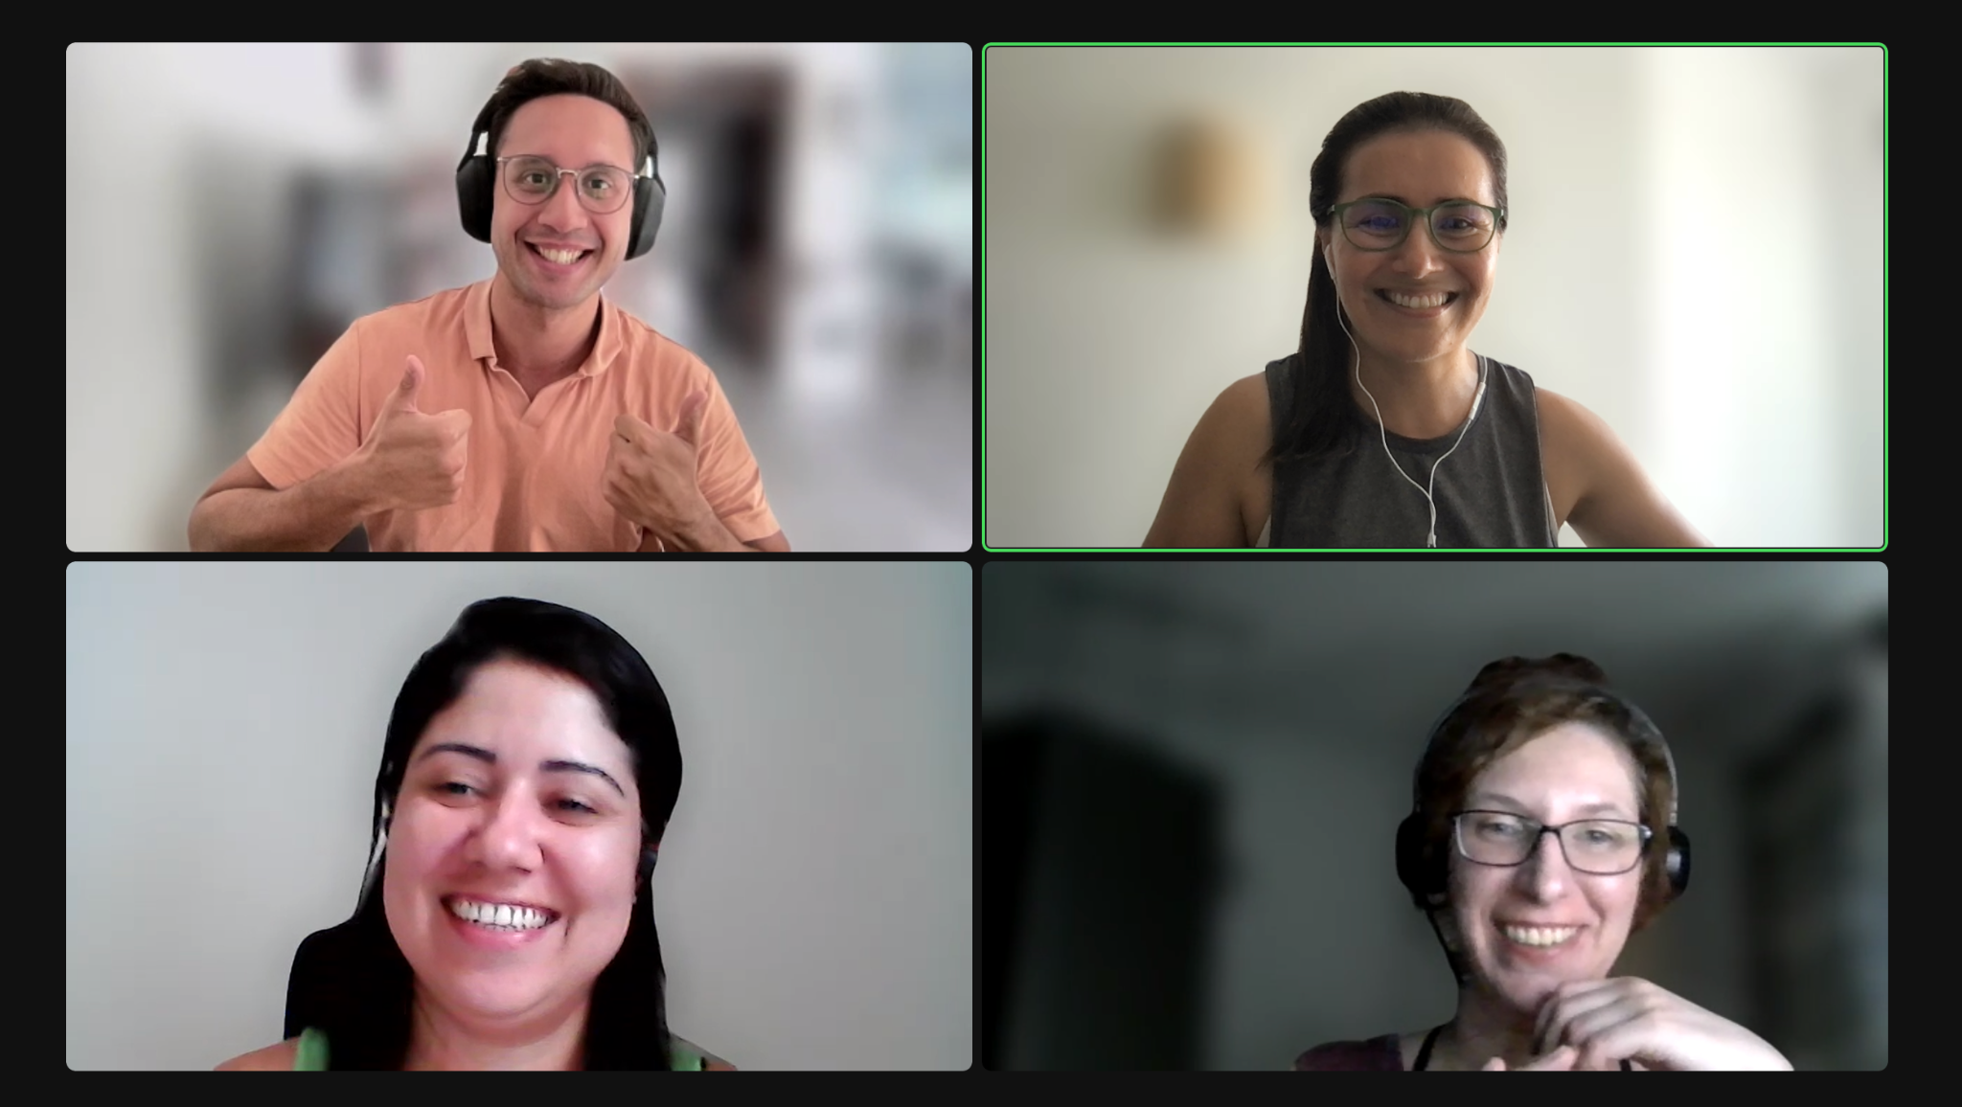

ESCAPE GAME
GROUP 5
Paola
Tania
Loredane
Jean Philippe
THANK YOU
Paola
Tania
Loredane
Jean Philippe

